Slide 1
Machine Learning
Implementation
Adithya dev K P
Varun Bondalapati
Karan Moza
P.Satya Pranav

Slide 2
Adding masks to a small dataset of 5 classes
We considered a small dataset of 5 classes indicating 5 different people.
Each class contains images of a person in different angles on different occasions.
This would help us in training to increase the fitting of the model, to avoid underfitting on any occasion.
In this process,we can add masks of different models, colors and patterns.

Slide 3
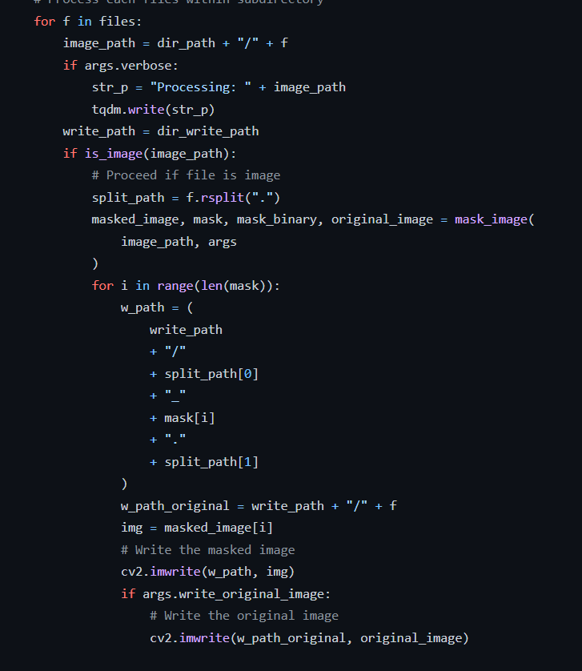
Working of MaskTheFace
Finding key points on face using dlib,such as nose,mouth ,eyes etc.
Consideration: Key points on the face to mask Tilt of the face

Slide 4
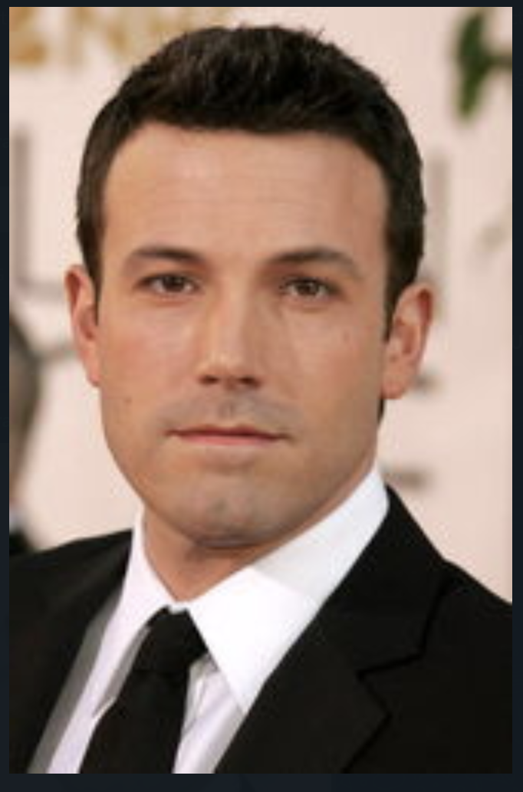
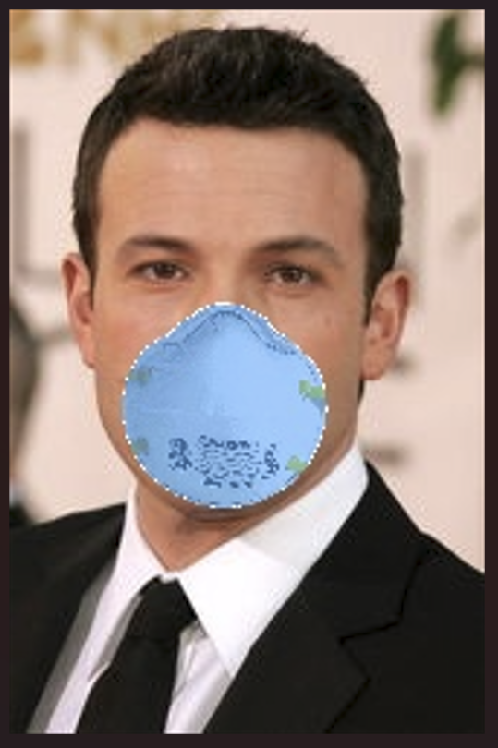
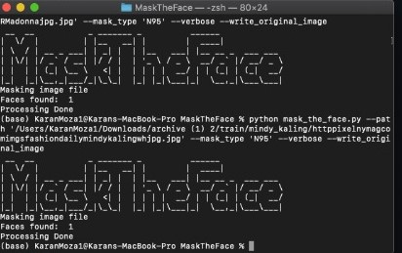
BEFORE Masking Algorithm AFTER

Slide 5
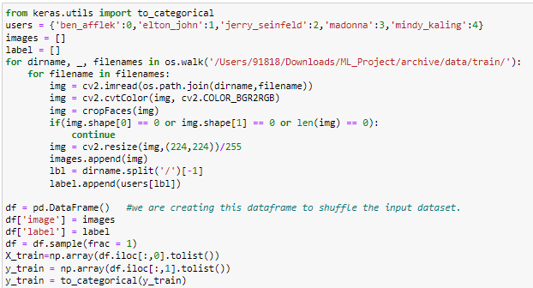
Running the unmasked dataset in pretrained model
Model used: Pretrained ResNet-50
Training the pre-trained model using unmasked data
Then running them on masked data.

Slide 6
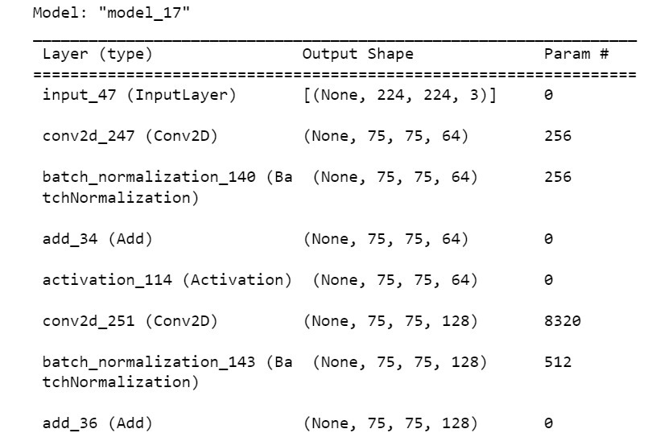
BEFORE RESNET-50 AFTER(Ben Affleck class detected)

Slide 7
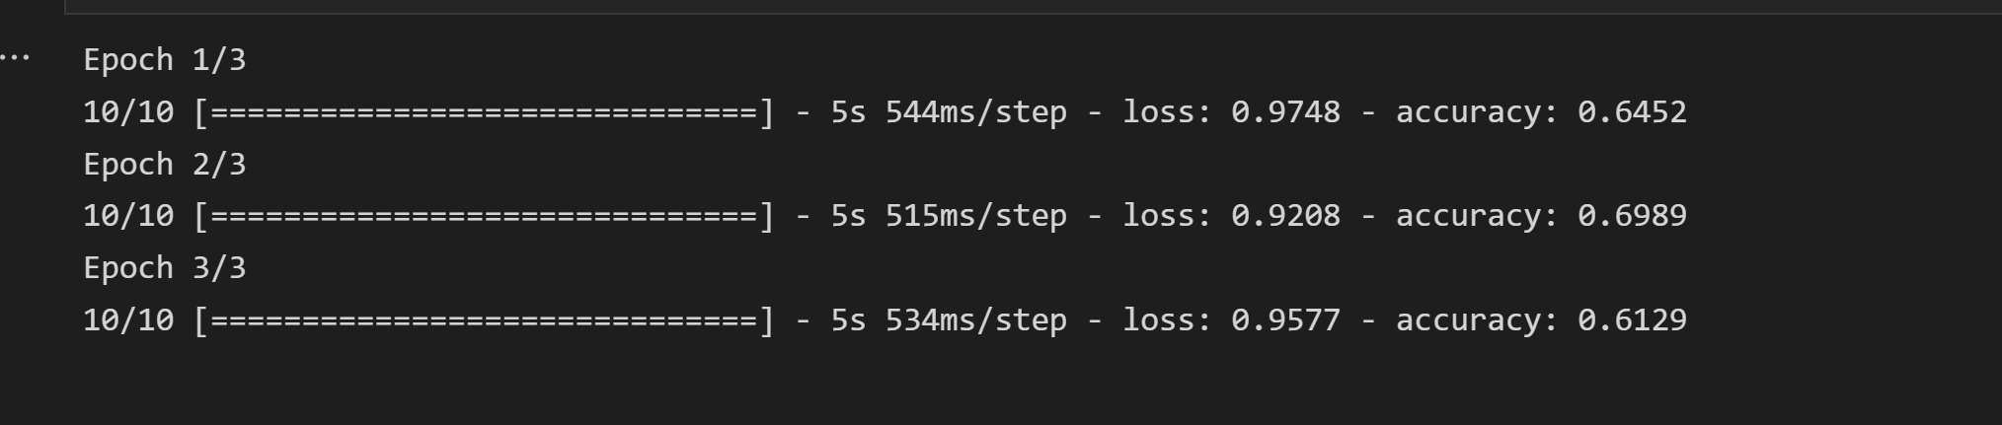
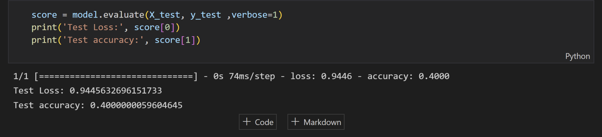
Results of trained model

Slide 8
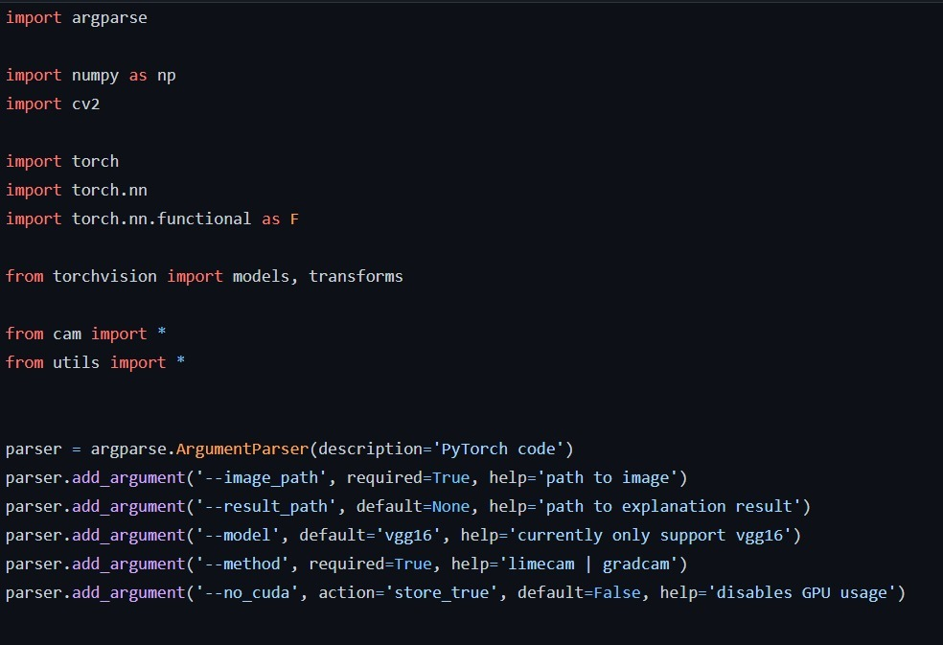
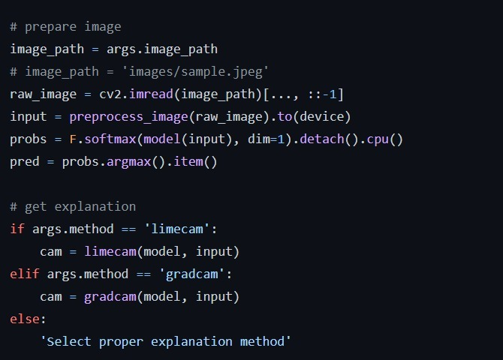
Code Snippets:

Slide 9
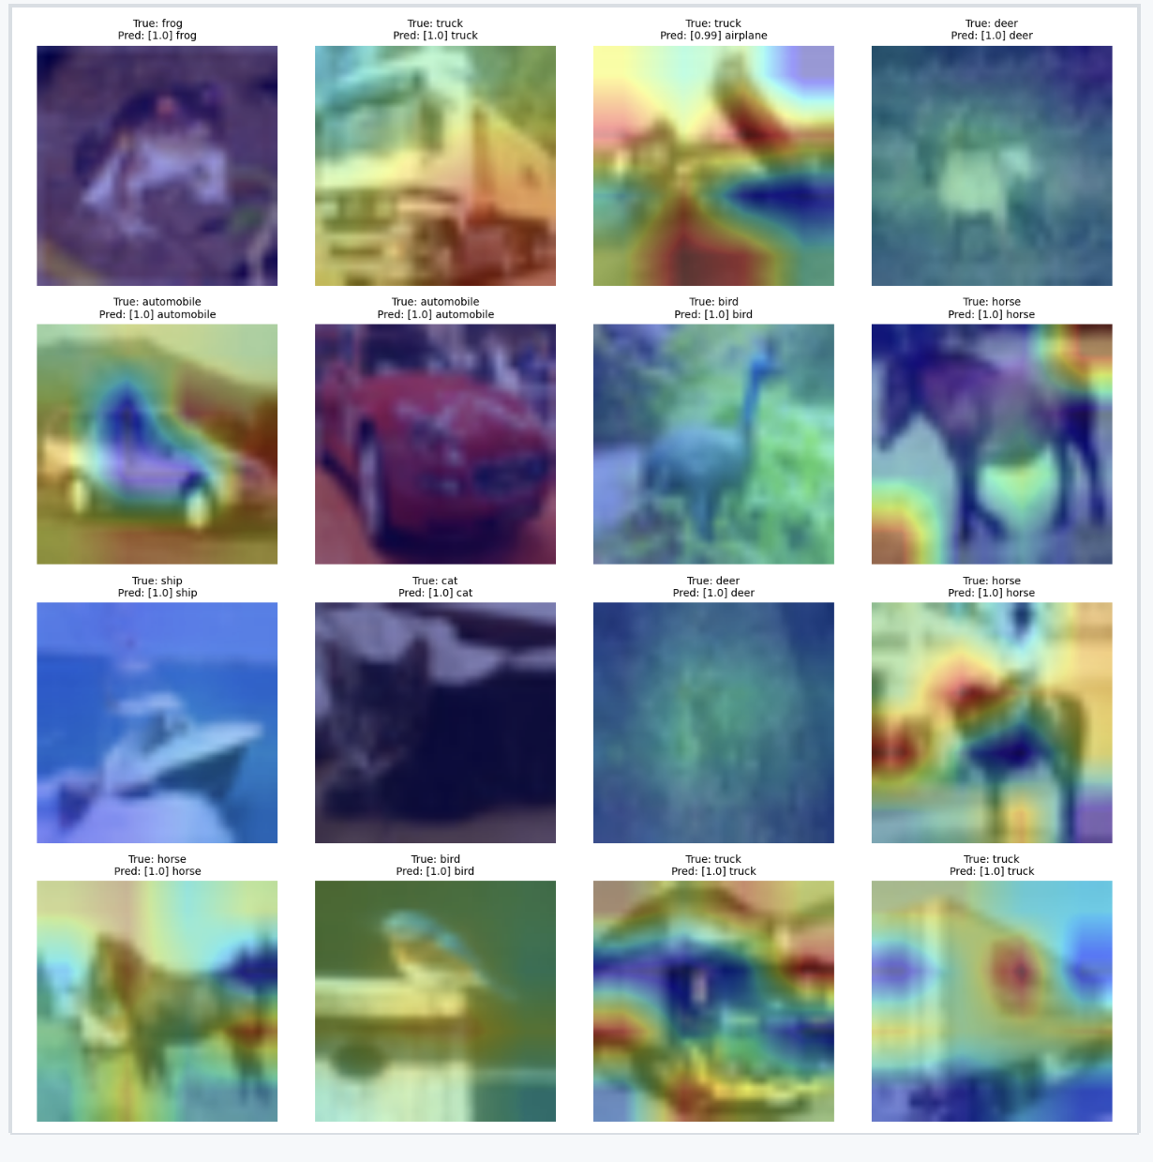
Explaining using GRADCAM
Creates Heatmaps of all the available classes in all the possible orientations.
This Heatmap visualization gives us the features which help in the explainability part while recognizing masked faces.
The last layer of model is given as an input to the GradCAM and the features collected by it are used to map it on the given masked face.

Slide 10
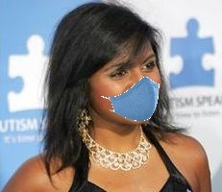
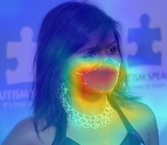
Before training the model, GradCAM only recognizes the mask and considers it to be the important feature.

Slide 11
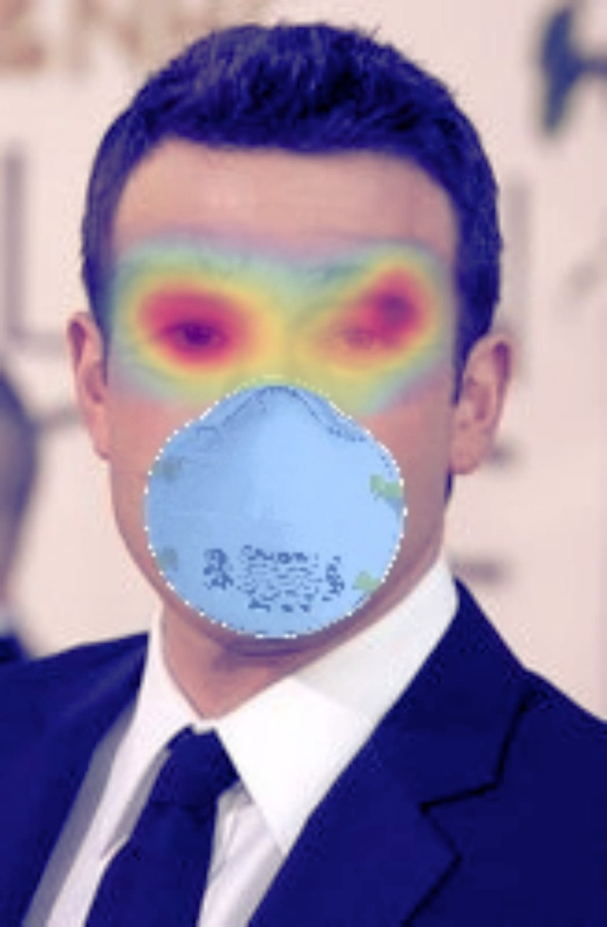
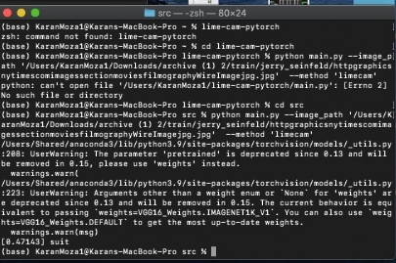
BEFORE GRADCAM AFTER

Slide 12
Further proceedings
Few points which can increase the accuracy and focus on most important features: More images of the class to increase the number of features Unmasking the masked data using GAN techniques Training ResNet-50 from scratch instead of using pre-trained model Checking out explainable AI techniques which provide a balance between accuracy and explainability

Slide 13
References
https://github.com/tuna-date/Face-Recognition-with-InsightFace
https://github.com/aqeelanwar/MaskTheFace/blob/master/mask_the_face.py
https://github.com/KaihuaTang/ResNet50-Pytorch-Face-Recognition
https://github.com/Caoliangjie/pytorch-gradcam-resnet50
https://pyimagesearch.com/2020/03/09/grad-cam-visualize-class-activation-maps-with-keras-tensorflow-and-deep-learning/

Slide 14
Thank you

